Slide 1
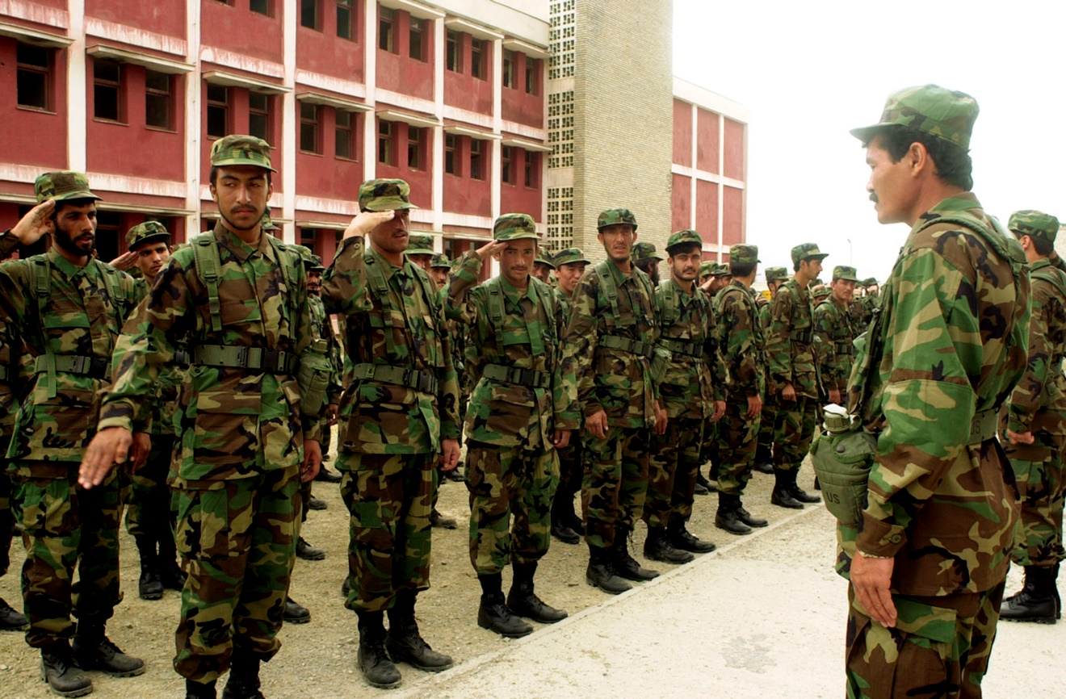
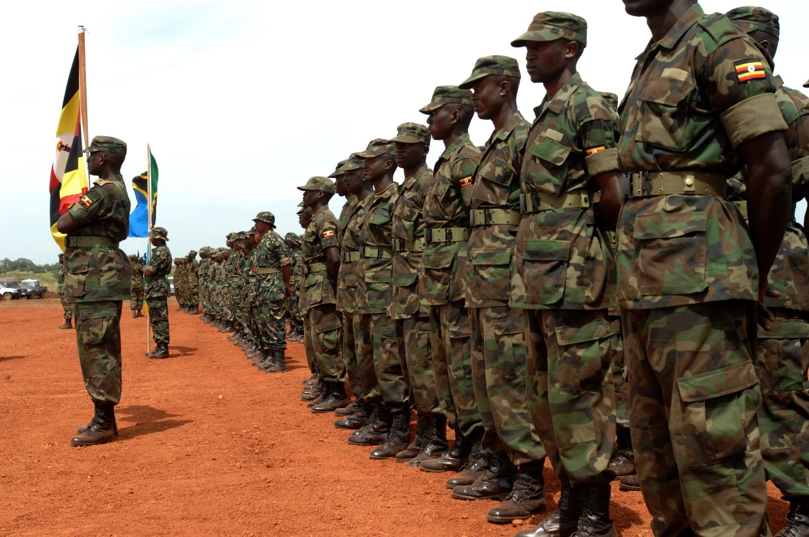
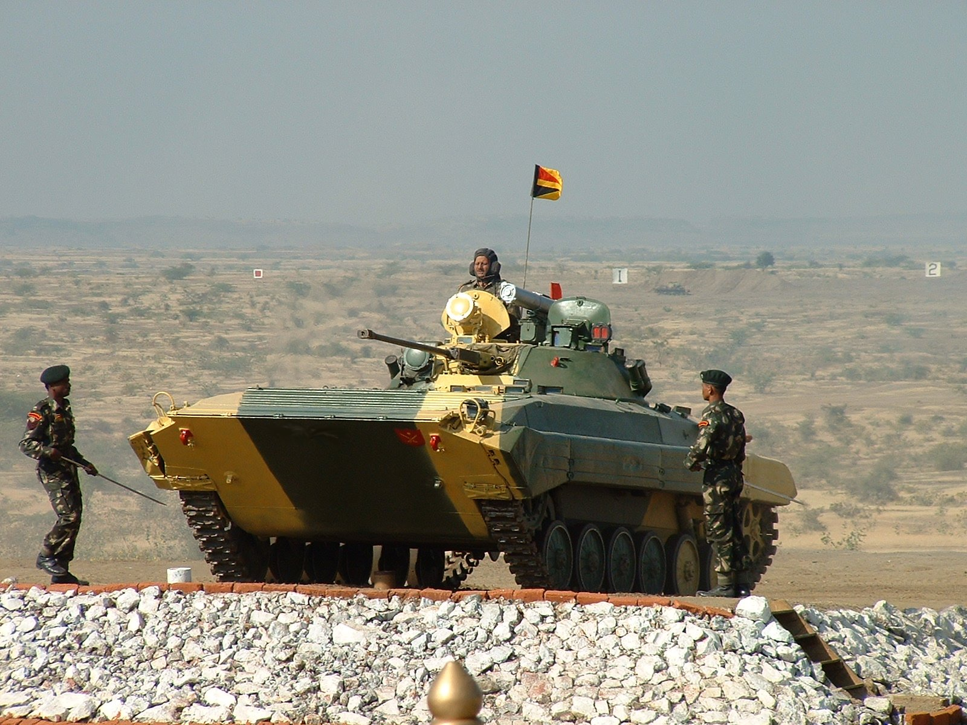
Army life
Germany
South Africa
Places our parents/carers have been.
Austria
Kenya
Washington dc
Afghanistan

Slide 2
I have lived in…
And a few more that I don’t remember
Birmingham (I was 3-6 years old then)
Surrey (I was 6-8 then)
Here (I am 9 now)
Conclusion a lot of places!!!!!!

Slide 3
Now for some different army`s

Slide 4
No not a kitten army
Our army
The us army

