Slide 1
Welcome to my worship!

Slide 2
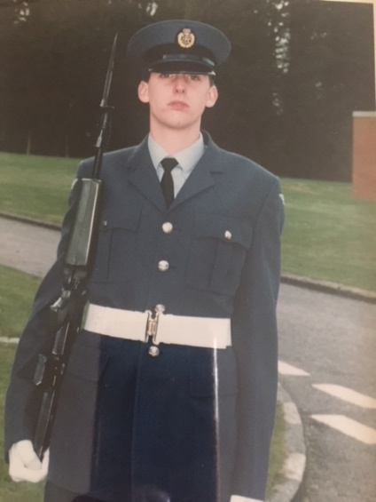
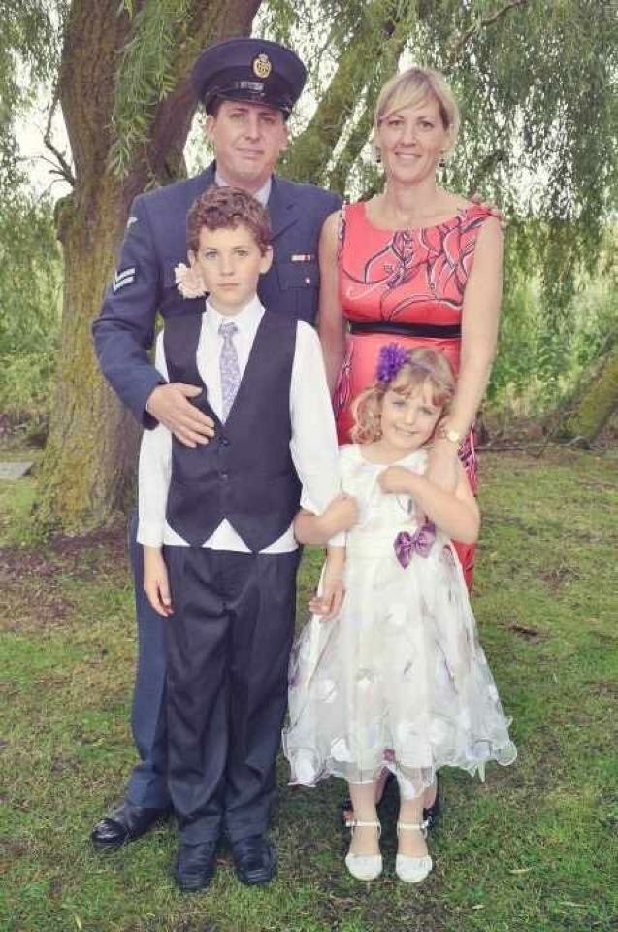
How does it feel to be a forces child?
By Holly Johnson

Slide 3
When being a forces child its not a good feeling!
Being a forces child mean that you parents are in and out of the country. When your parents leave its like somethings missing. Your feel depressed and most the time there is no one to talk to who actually understands your feelings. Currently my dad is in Romania. He has been gone since may and wont be back till mid September. Its really not a good feeling.

Slide 4
What's the difference?
There are A LOT of differences most kids and people have the luxury of seeing their parents all day and all night. Not for us we barely see our parents. They go on “holiday” a lot as they get shipped to different Country's from being in the RAF.

Slide 5
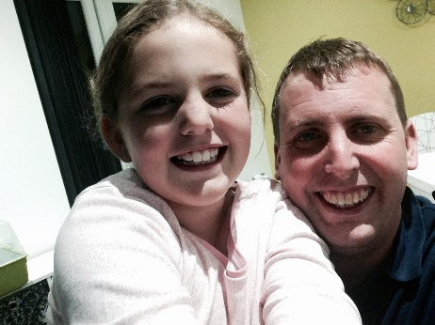
Pros and cons
Pros
Thanks to Mrs Eastwood we have camo club for all the forces children, we go and RAF trips, when you parents go around the world we go on holiday to visit them so we go al the way round the world. And when your parents do come home your really happy
Cons
There are lots more cons than pros. When your parents are on the other side of the world for so long its not fun. When you don’t see your parents because of night shift. Struggling with not having them around and many more.

Slide 6
Why does it even happen?
Because of their job, they need to move houses go to different countries and in the end its just something you need to get used to. Sadly, it does happen every day to kids and family's who have parents, husbands, wife left them to go around the world or round England moving houses.

Slide 7
? Guessing Game ?

Slide 8
Guess who many times Izzy and Ruby have moved house ??
Guess how many times we’ve been on a RAF school trip??
Guess what RAF stands for?
Guess what date the RAF created
5 times
Cinema
RAF Cranwell
Picnic
Royal Air Force
April 1st 1918
____.1.19__

