Slide 1
The life of a Armed Forces child

Slide 2
Being a forces child is hard, many people struggle because their parents are away. It can be tough.
My dad in the Falkland Islands with an elephant seal.

Slide 3
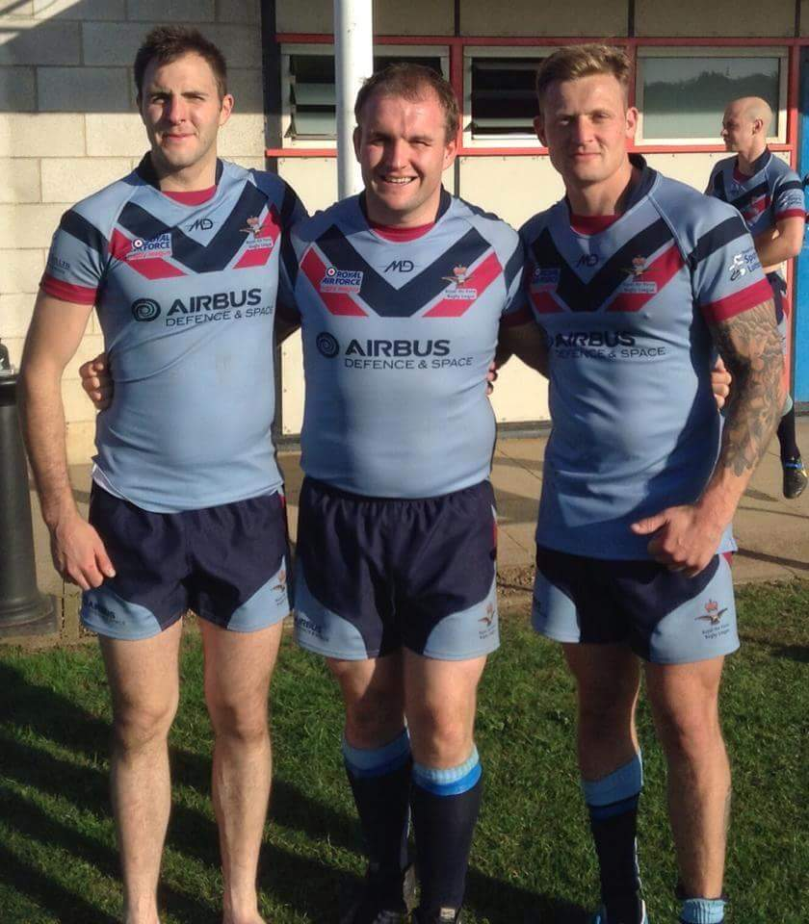
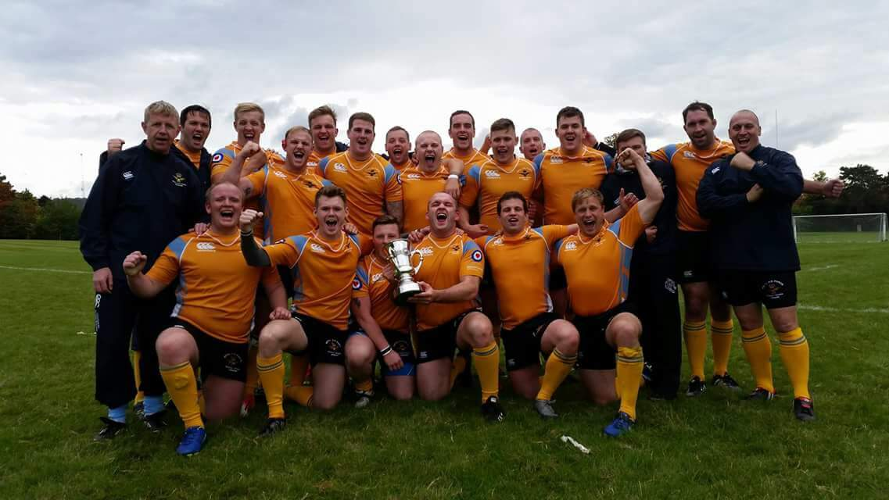
The good.
Going on school trips like The cinema and RAF Cranwell
Your parents going to new places
You watching them in sporting events such as Rugby

Slide 4
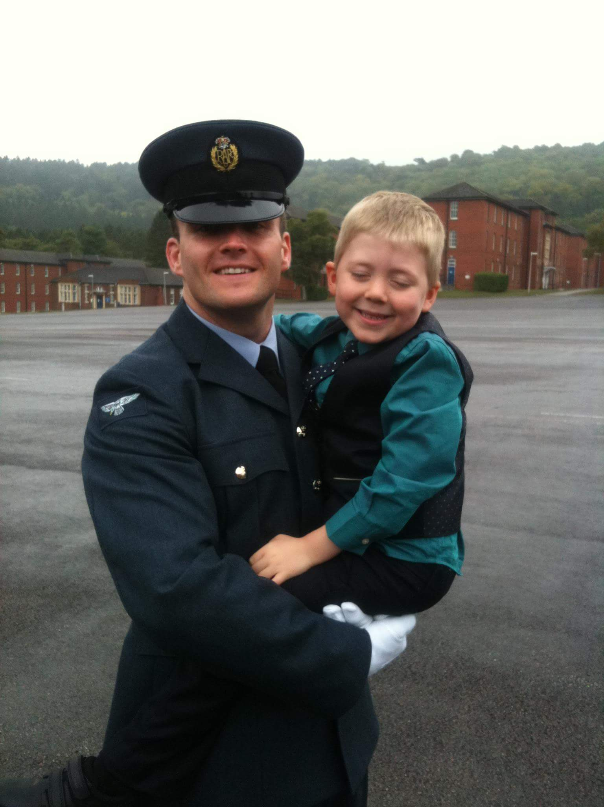
The bad.
Leaving houses and good friends
They go away a lot
You miss them for a long period of time
They miss birthdays, Christmas’ and events

Slide 5
Guess who?
Holly’s dad
Luke’s dad

Slide 6
The time when
The Navy was formed in 13th of October 1775 Philadelphia, Pennsylvania, United States
The Army was formed in 1660 United Kingdom

