Slide 1
Expectations for Year 1
Spelling

Slide 2
Expectations for Year 2
Spelling

Slide 3
Expectations for Year 3
Spelling

Slide 4
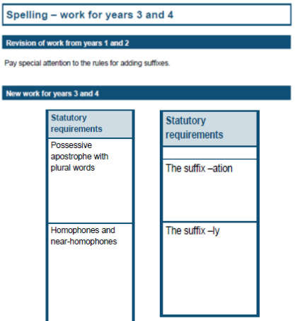
Expectations for Year 4
Spelling

Slide 5
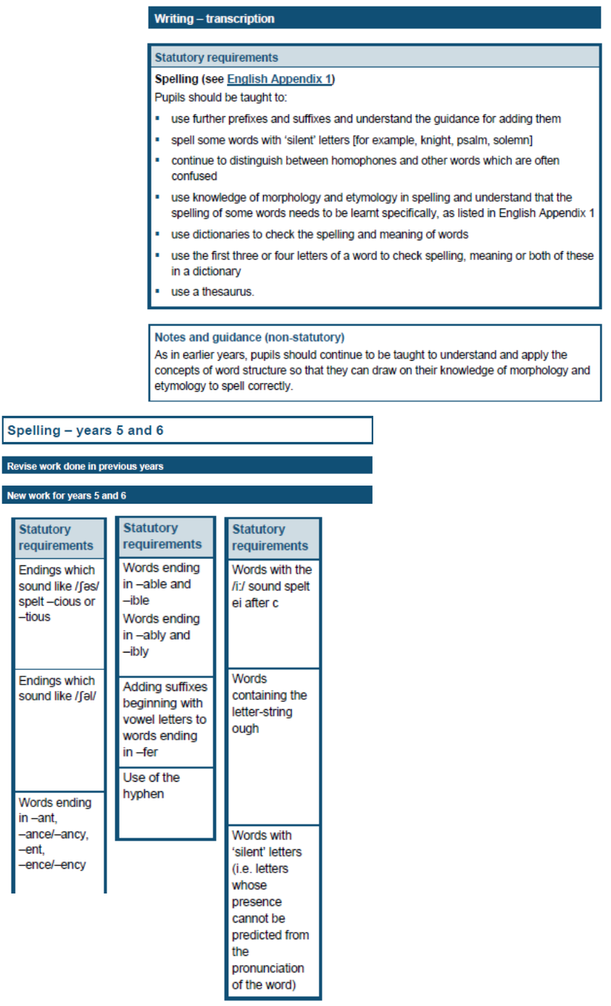
Expectations for Year 5
Spelling

Slide 6
Expectations for Year 6
Spelling

